Slide 1
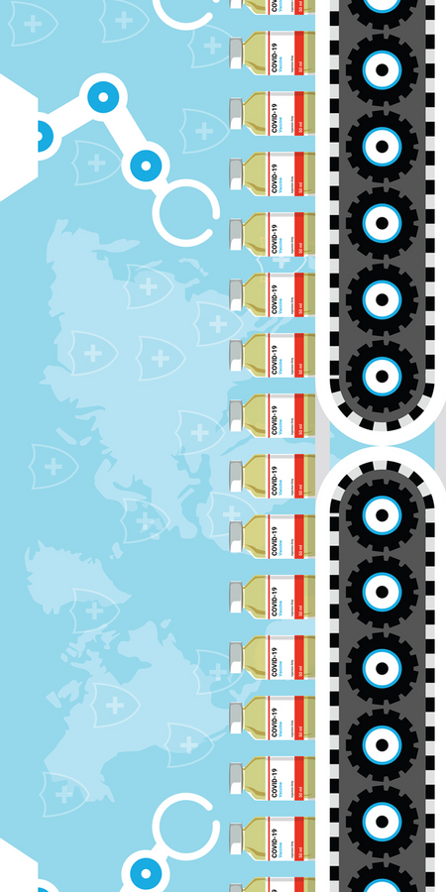
Machine Learning for
Ultralow Vaccine Distribution
COLD-CHAIN MONITORING | AUGUST 2026
Exploratory public-data analysis plus a local event-to-dashboard prototype
Notes:
[Sources]
Public-data notebook: ML_questions_Ultralow_Vaccine_Distribution_Data.
Project artifacts: sensordashboard/README.md; sensordashboard/docs/terminal-runbook.md.
The deck distinguishes public-data findings, local synthetic software behavior, and planned physical-sensor work.

Slide 2
The public dataset established the ML baseline
The notebook uses 112,267 raw readings across 57 temperature channels. The new prototype keeps this analysis separate from its simulated event stream.
112,267
57
112,266
raw public rows loaded
temperature channels
rows used for next-change models
Notes:
[Sources]
ML_questions_Ultralow_Vaccine_Distribution_Data notebook.
sensordashboard/README.md.
The counts remain the notebook's public-data baseline; they are not counts from the live prototype.

Slide 3
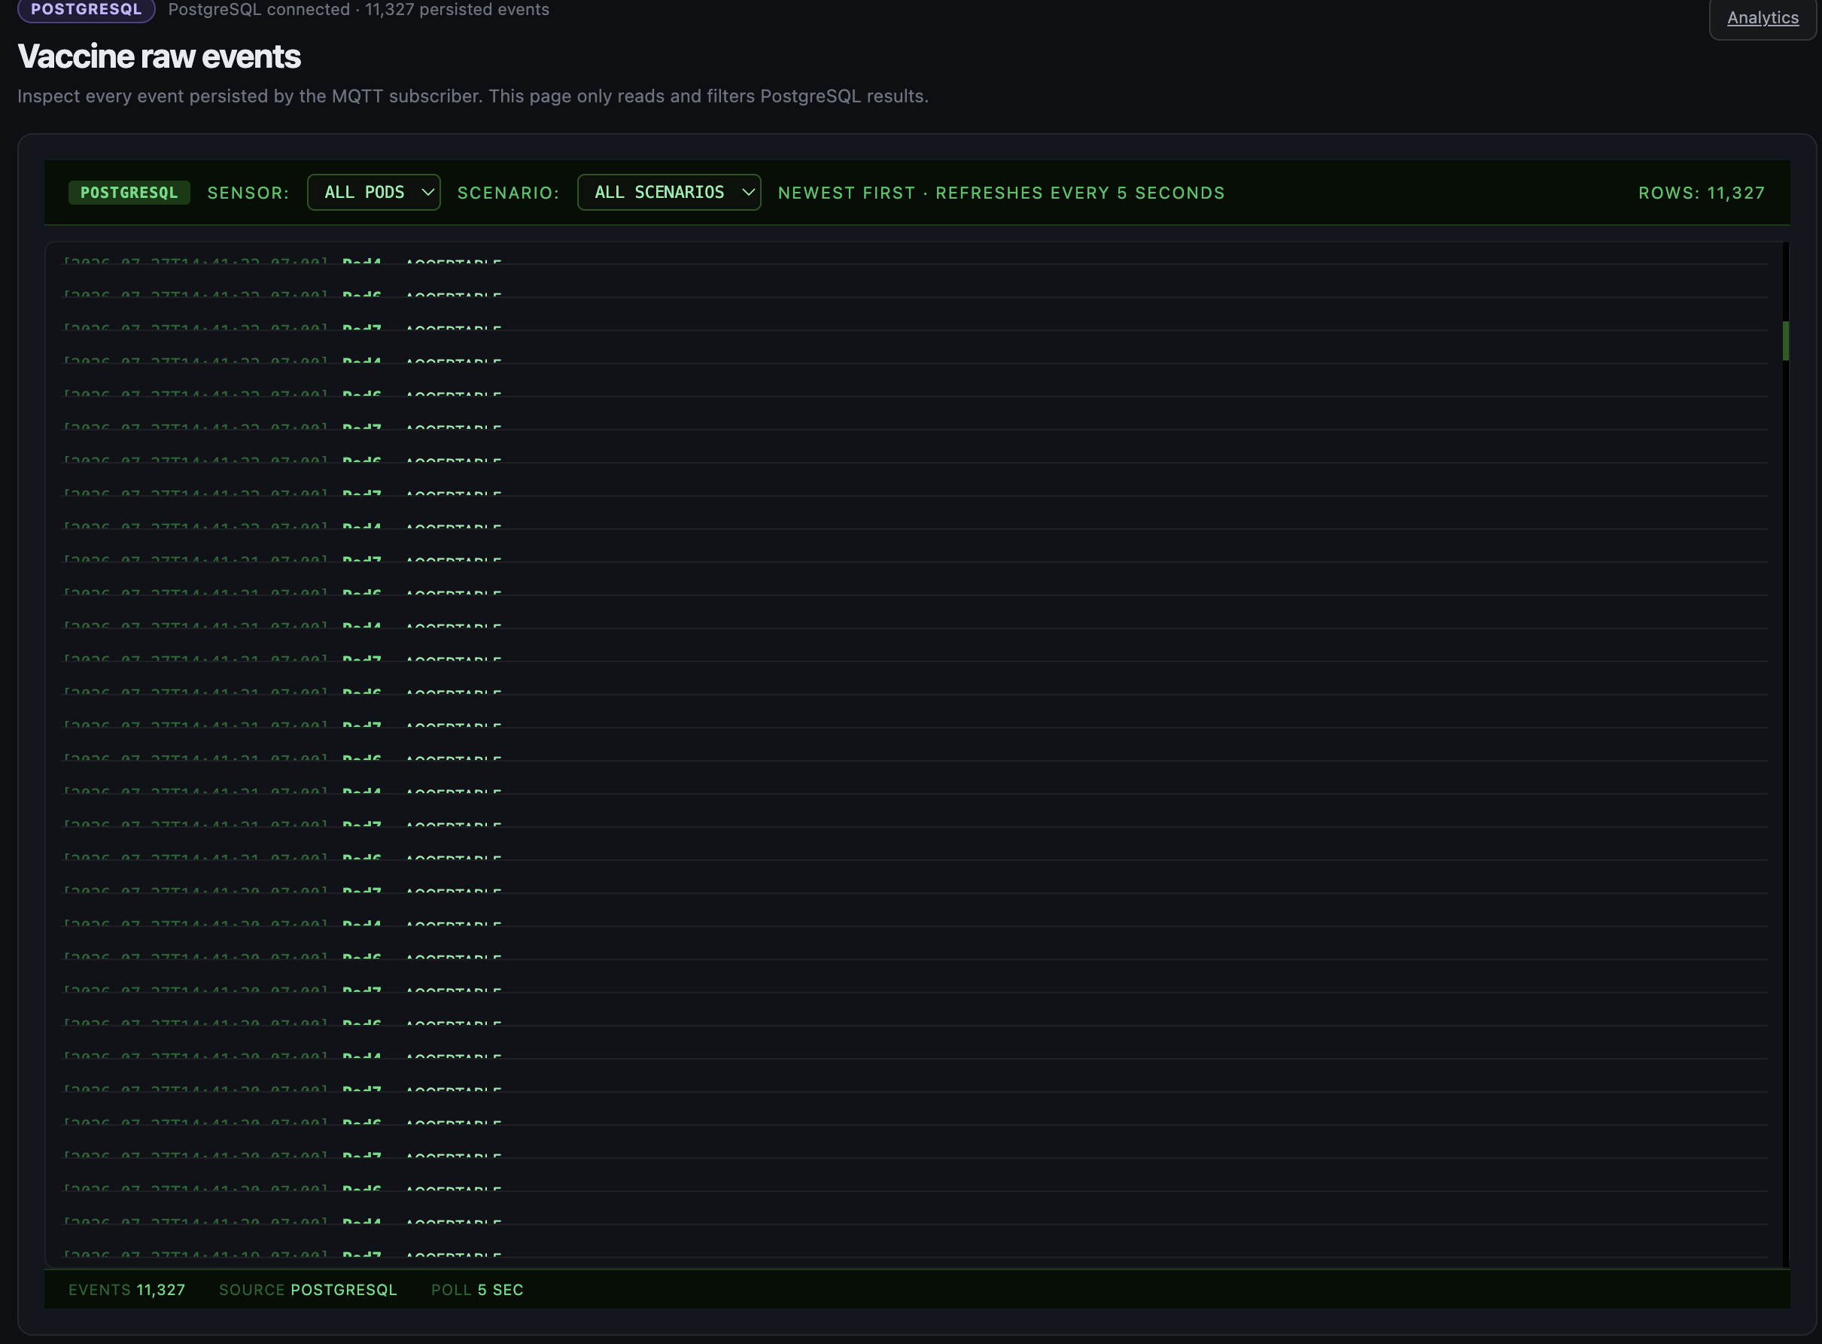
Sensor agreement became a validation screen
Can an existing sensor relationship prioritize review?
Sensor A predicts Sensor B with R² = 0.775
This public-data result supports a consistency check: large departures from the fitted relationship can flag disagreement or placement issues.
Prototype boundary: the current dashboard surfaces sensor variation and uncertainty; it does not claim calibrated sensor fault detection.
Notes:
[Sources]
ML_questions_Ultralow_Vaccine_Distribution_Data notebook.
sensordashboard/web/pages/domain-vaccine.html.
R² = 0.775 is a dataset result and should be treated as a validation screen, not a calibrated sensor-fault claim.

Slide 4
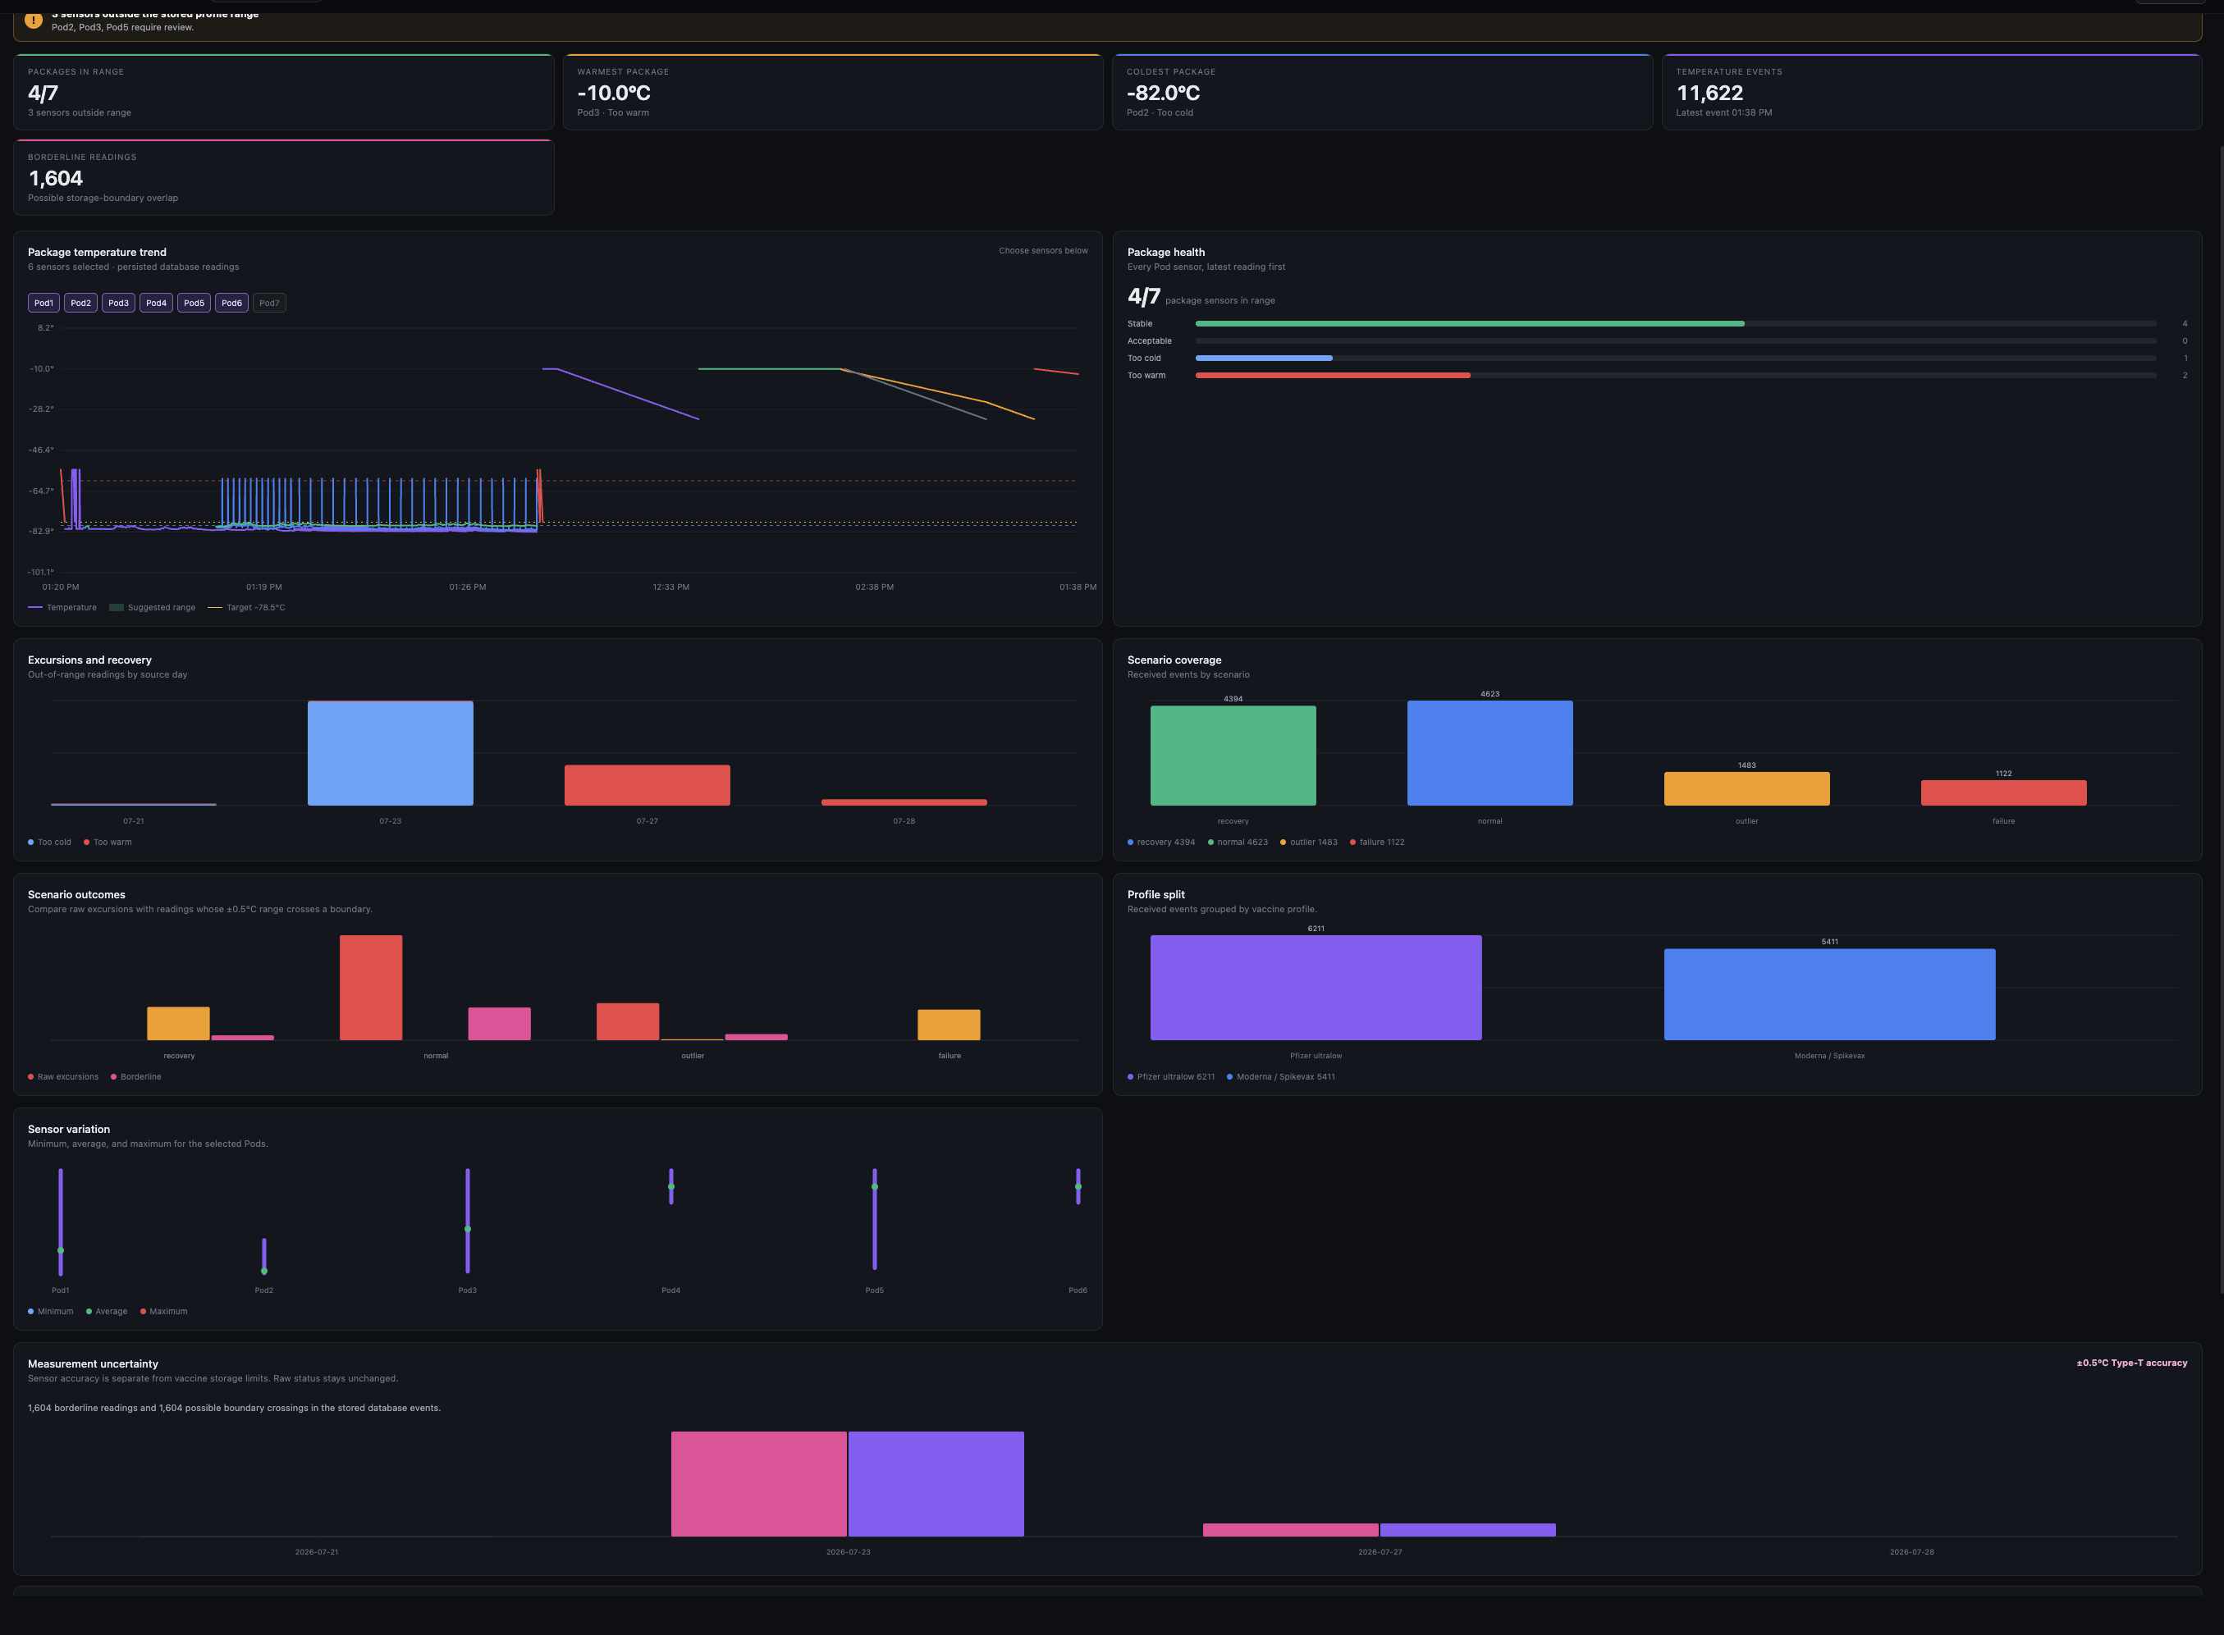
The review label became deterministic scenarios
Can unusual changes be reviewed without calling them confirmed failures?
11,228 of 112,266 windows are labeled for review
The prototype now generates normal, warning, recovery, mixed, and outlier scenarios with stable seeds.
These scenarios exercise the dashboard and persistence path; they are not clinical ground truth.
Notes:
[Sources]
ML_questions_Ultralow_Vaccine_Distribution_Data notebook.
sensordashboard/services/temperature_event_generator.py.
sensordashboard/tests/test_generator_scenarios.py.
The scenario names and deterministic behavior are software-test artifacts, not clinical labels.

Slide 5
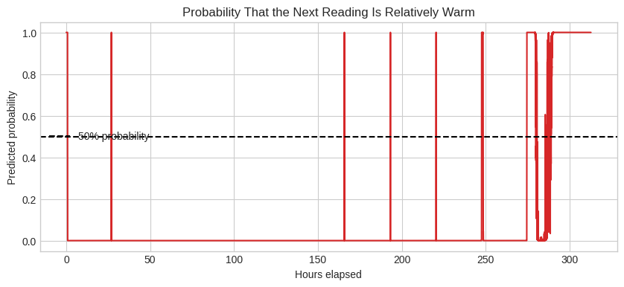
Relative warm probability is not a vaccine-safety probability
What does the saved model actually estimate?
“Warm” means the warmest 10% of next readings in the public dataset.
The new inference service applies saved parameters to one event and returns advisory context.
It does not estimate the probability of crossing a product-specific vaccine threshold.
Notes:
[Sources]
ML_questions_Ultralow_Vaccine_Distribution_Data notebook.
sensordashboard/services/ml_inference.py.
learning-records/0003-ml-inference-pipeline.md.
The public-data warm label is relative to the dataset; the inference service does not convert it into a product-specific safety threshold.

Slide 6
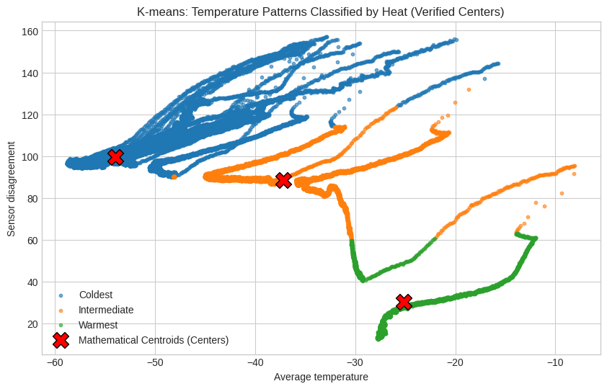
K-means stays descriptive until context is labeled
What can clustering contribute to a monitoring workflow?
Rows are grouped by mean temperature and sensor spread; three observed patterns appear.
In the prototype, trend and clustering are secondary context and can return insufficient_data.
Without cause labels or a held-out test, clusters are descriptive—not causal.
Notes:
[Sources]
ML_questions_Ultralow_Vaccine_Distribution_Data notebook.
sensordashboard/services/ml_inference.py.
sensordashboard/tests/test_ml_inference.py.

Slide 7
What is implemented, and what remains bounded
The project now connects public-data learning questions to a local, reproducible software path—while keeping clinical and physical-sensor claims explicitly out of scope.
Evidence source | Method | Current answer | Artifact | Boundary
Public dataset | Linear / logistic / K-means | Review proxies work | Notebook charts | Dataset-relative
Synthetic events | Seeded scenarios | Normal → outlier paths run | Generator + tests | Not physical data
MQTT + PostgreSQL | Validate + dual write | Events persist | Raw event stream | Local demo
Dashboard bridge | Read-only browser path | Ops view works | Analytics + raw | No disposition change
ML service | Saved-model inference | Advisory outputs | Inference tab | No retraining
Physical plan | Arduino sensors | Not completed | Future extension | No facility validation
Notes:
[Sources]
ML_questions_Ultralow_Vaccine_Distribution_Data notebook.
sensordashboard/README.md.
sensordashboard/tests/.
This table is an evidence map. It separates observed notebook behavior, local software behavior, and planned physical or facility validation.

Slide 8
A temperature event now has a durable evidence path
How does one simulated event reach the browser?
Generator → MQTT → subscriber validation → PostgreSQL dual write → read-only bridge → browser.
The raw-events view shows the persisted side of that contract, including PostgreSQL connection, filters, and event rows.
This is a local synthetic pipeline; the physical sensor feed is planned.
Notes:
[Sources]
Visual: sensordashboard/archive/artifacts/stitch-upload-package/references/current-raw-events.png.
Implementation: sensordashboard/README.md; sensordashboard/services/event_contract.py; sensordashboard/services/temperature_subscriber.py; sensordashboard/services/dashboard_bridge.py.
The screenshot is a project artifact showing a persisted-event read surface, not an external product screenshot.

Slide 9
The dashboard turns scenarios into inspectable operating signals
What can the browser show today?
Analytics combines status, excursion/recovery counts, scenario coverage, profile split, sensor variation, and uncertainty.
Normal, warning, recovery, mixed, and outlier runs can be replayed deterministically to exercise the view.
The browser reads through the bridge; it does not write PostgreSQL or change vaccine disposition.
Notes:
[Sources]
Visual: sensordashboard/archive/artifacts/stitch-upload-package/references/current-analytics.png.
Implementation: sensordashboard/README.md; sensordashboard/web/pages/domain-vaccine.html; sensordashboard/web/scripts/vaccine-data.js.
Dashboard values are synthetic demo data and are included to show the implemented monitoring surface, not a clinical performance result.

Slide 10
ML is integrated as read-only advisory context
What happens when the Inference tab receives one event?
Training is a separate step that writes a saved model bundle.
The service loads it once, scores one event, and returns advisory logistic, trend, and cluster outputs.
The result is advisory: no retraining, database writes, or operational disposition changes occur during inference.
Notes:
[Sources]
learning-records/0003-ml-inference-pipeline.md.
sensordashboard/services/ml_inference.py.
sensordashboard/services/ml_service.py.
sensordashboard/tests/test_ml_inference.py.
The existing chart remains as the public-data visual context; the surrounding copy now explains how that learning work is kept read-only in the prototype.

